Slide 1
Current Trends ALTA Forms E-Remit and E-Submit CATIC Services QUIZ TIME!

Slide 2
Notary Stuff
Notarization – 26 VSA Chapter 103, Subchapter 4
Seemingly little known facts to a lot of notaries:
Stamp is required by law:
26 VSA §5367 (b)(1) “an official stamp shall be affixed to or embossed on the certificate”
Is there a lesser alternative?
Yes - CLEARLY print name AND commission number.
What goes in a stamp?
26 VSA §5369: “The official stamp of a notary public shall:
include the notary public’s name, jurisdiction, and other information required by the Office; and
be capable of being copied together with the record to which it is affixed….
Why wouldn’t a notary public use an INK STAMP every time?
Andrew D. Mikell
Notary Public, State of Vermont
Commission expires: 1/31/2023
Credential #: 157.0000773

Slide 3
Notary Stuff
Personal appearance is required (“Before Me”).
26 VSA §5364 (b): “The requirement for a personal appearance is satisfied if:
The notary public and the person executing the signature are in the same physical place; or
The notary public and the person are communicating through a secure communication link using protocol and standards prescribed in rules adopted by the SOS…”
Notaries are liable under the statute.
RIN : EXPIRED!
E. Rules Covid - subject to expiration
Everyone must be in VT
For title insurance purposes we require use of the
California style certificate adopted by the VBA
RON: Not yet permitted but coming soon (?)
Foreign: Embassy; Consulate; Apostille, compliance with foreign jurisdiction

Slide 4
E-Searching?
Doing electronic title searches? Things to think about:
Trust no indexing
Typos
Inconsistent indexing practices
Non-indexed parties (e.g. Grantor who joins a deed/mortgage)
Commas, periods, apostrophes, dashes, The
Know the “current recording date”
May be days, weeks, months behind
May require a trip to the land records
Search and then Search By Property Address
Enter “minimum values” especially easy for unusual names
e.g. Michelin, Thomas “Mich T”
Other helpful tips anyone wants to share?

Slide 5
Powers of Attorney
POWER OF ATTORNEY (“POA”)
FOR REAL ESTATE TRANSACTIONS ONLY
Principal: ___________________________________________
Agent: ____________________________________________
Property Address: ____________________________________, Vermont (the “Property”)
Term: Ninety (90) days duration from the date of execution.
In connection with the Property, I appoint the Agent to act in my name and place, to the fullest extent which I could act if I were personally present for the transaction described below.
Delegation: I appoint the Agent, or any individual Agent acting solely, to act for me in the purchase, purchase and finance, sale, or refinance, of the Property, doing any and all actions that I might do if personally present to effectuate the transaction.
Durable: This POA shall not be affected by my subsequent disability or incapacity.
Delegation: The Agent may delegate the powers granted to the Agent by this POA by a delegation in writing which makes reference to this POA and which otherwise complies with applicable law.
In witness whereof, I execute this instrument this ______ day of ______________, 20___.
Principal Principal
_______________________________________ _____________________________________
Printed Name: _________________________ Printed Name: ______________________
Affirmation by Witness
I, _________________________________ [insert printed name of witness] witnessed the signature of the Principal, and I affirm that the Principal appeared to me to be of sound mind, was not under duress, and the Principal affirmed to me that they were aware of the nature of this POA and signed it freely and voluntarily.
_______________________________
Witness
State of ______________________
County of ____________________, S.S.
This record was acknowledged before me by the Principal named above on __________________, 20___.
________________________________________
Notary Public
Printed Name: _____________________________
Commission Expires: _______________________
Commission Number: _______________________
[Apply Notary Stamp above]

Slide 6
Mobile Home Issues
Issues:
Failure to obtain affidavit of affixation at closing.
Failure to anticipate that lender will want ALTA 7.1 MH Endorsement
Failure to collect $100 endorsement fee
Failure to remit the proper premium with policy
Failure to attach hard copy of endorsement to the policy
Other…..

Slide 7
Planned Communities - PUD
The lender…
says it’s a PUD because the appraiser said so;
says it needs a PUD endorsement;
wants to know if this is a PUD
Planned Unit Development (pick one):
Local Zoning Term; and/or
Secondary Market Term
Secondary Market: PUD = Planned Community
What’s a Planned Community?
A CIC and Common Elements are owned by the HOA

Slide 8
Glebe land; Lease land
Reference to lease land or glebe land?
Possibilities:
Municipal owns the fee;
3rd party owns the fee (SPG, College);
Never was lease land (over inclusive reference)
What to do?
Determine who owns the fee with historic search?
Then what?
If Municipality owns determine if it voted to retain prior to 1/1/20
If SPG owns it contact Episcopal Diocese
If UVM owns it contact UVM get release (subject to reservation)

Slide 9
Forms Committee
The purpose and scope of work of the Forms Committee is to:
Review, from time to time, the ALTA approved title insurance forms.
Recommend new forms or revisions of existing forms to keep title insurance coverage responsive to the needs of insureds and the industry and consistent with requirements of supervisory authorities.
Confer with representatives of insureds and supervisory authorities for the purpose of accomplishing the above objectives.

Slide 10
Who Does the Work?
ALTA FORMS COMMITTEE
60+ Individual Title Underwriters Contributed
20+ Title Insurers Were Represented
ALTA BOARD OF GOVERNORS
INDUSTRY PARTNERS AND CUSTOMERS
ALTA UNDERWRITER SECTION & SECTION EXECUTIVE COMMITTEE
ACMA & ACREL
FHFA, Fannie Mae, Freddie Mac
MBA, Lenders

Slide 11
HOW DO NEW FORMS GET ADOPTED?
THE PROCESS IS ONGOING
It Begins With An Idea
ALTA FORMS COMMITTEE
Develop, Draft, Review, Refine, & Recommend
ALTA BOARD OF GOVERNORS
Formal Adoption
PUBLIC COMMENT PERIOD & REVIEW OF COMMENTS
FINAL POSTING WITH EFFECTIVE DATE
INDUSTRY IMPLEMENTATION

Slide 12
DEFINITIONS

Slide 13
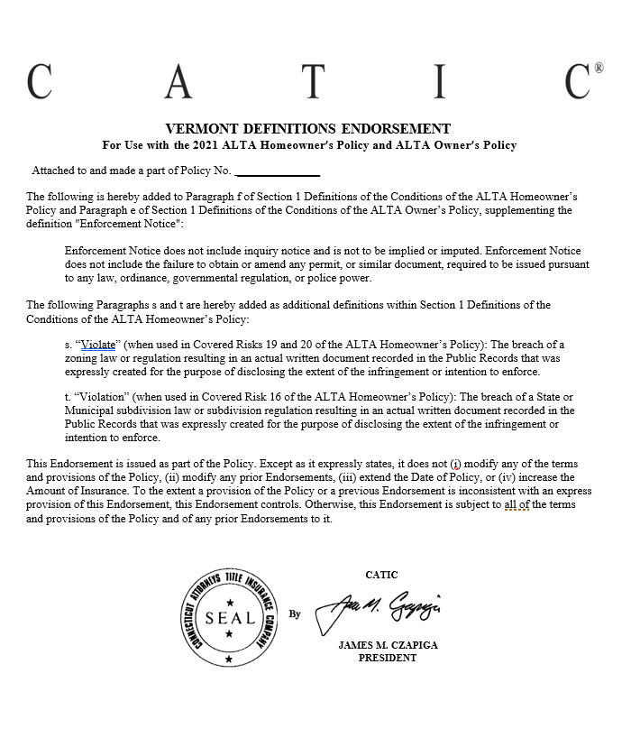
DEFINITIONS
Conditions
"Unmarketable Title”
“Public Records”
“Enforcement Notice”

Slide 14
COVERED RISKS AND ZONING VIOLATIONS – VERMONT
16. Because of a violation existing at the Date of Policy of a State or Municipal subdivision law or State or Municipal subdivision regulation affecting the Land:
a. You are unable to obtain a building permit from a Municipal authority;
b. You are ordered by a State or Municipal authority to remove or remedy the violation; or
c. someone else refuses to perform a contract to purchase the Land, lease the Land, or make a mortgage loan on the Land, based on that violation.
19. You are ordered by a State or Municipal authority to remove or remedy any portion of Your existing structures, because they violate an existing State or Municipal zoning law or State or Municipal zoning regulation. The Amount of Insurance for Covered Risk 19 is subject to Your Deductible Amount and Our Maximum Dollar Limit of Liability shown in Schedule A.
20. You are not able to use the Land because use as a single-family residence violates an existing State or Municipal zoning law or State or Municipal zoning regulation.

Slide 15
Continuation of Coverage
Defined:
Insured
…
(e) the grantee of an Insured under a deed or other instrument transferring the Title, if the grantee is:
(1) an Affiliate;
(2) a trustee or beneficiary of a trust created by a written instrument established for estate planning purposes by an Insured;
(3) a spouse who receives the Title because of a dissolution of marriage;
(4) a transferee by a transfer effective on the death of an Insured as authorized by law; or
(5) another Insured named in Item 1 of Schedule A.

Slide 16
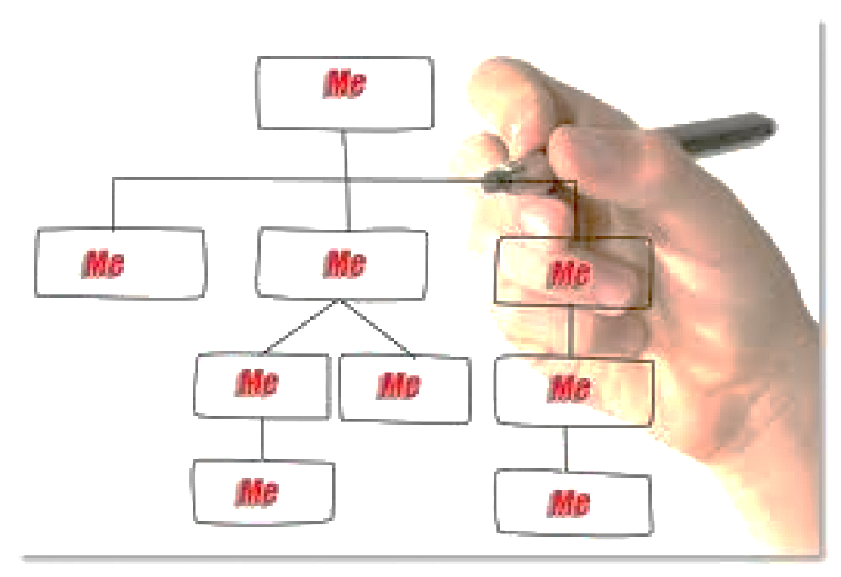
An Entity: i. that is wholly-owned by the Insured; ii. That wholly-owns the Insured; or iii. If that Entity and the Insured are both wholly-owned by the same person or entity
“AFFILIATE” – Standard OP

Slide 17
Electronic Signatures/Notarization
1.) Jacket
Incorporates ALTA 39 Authentication Endorsement:
As long as the Insurer issues the policy with a Policy Number and Date of Policy, the policy is valid even if issued electronically or without any signatures.
2.) Covered Risks
A defect in the Title caused by:
a document affecting the Title not properly authorized, created, executed, witnessed, sealed, acknowledged, notarized, (including by remote online notarization), or delivered; …
the repudiation of an electronic signature by a person who signed the document because the electronic signature was not valid under applicable electronic transactions law.

Slide 18
NEW POLICY JACKET INTRODUCTORY LANGUAGE

Slide 19
Title Insurance Policy Jacket and Vermont Law
Some historical land records contain Discriminatory Covenants that are illegal and unenforceable by law. This policy treats any Discriminatory Covenant in a document referenced in Schedule B as if each Discriminatory Covenant is redacted, repudiated, removed, and not republished or recirculated. Only the remaining provisions of the document are excepted from coverage.
S.144/Proposed 27 V.S.A § 546. CERTAIN RESTRICTIVE COVENANTS IN DEEDS VOID; PROCESS FOR REMOVAL
(a) Any restrictive covenant and any related reversionary interest that purports to restrict occupancy or ownership of property on the basis of race, ethnicity, or religion is declared to be void and contrary to the public policy of the State of Vermont. This subsection shall apply to any restrictive covenant executed at any time.

Slide 20
COVERAGES
Broadened Coverage
Environmental Protection Environmental Protection and Remediation
Broadened Coverage
Governmental Police Power Governmental Forfeiture, Police, Regulatory, or National Security Power
Improved Coverage
Expanded Mortgagee Policy Survey Coverage boundary line overlaps
Updated Coverage
Fraudulent Transfers Act Voidable Transactions Act

Slide 21
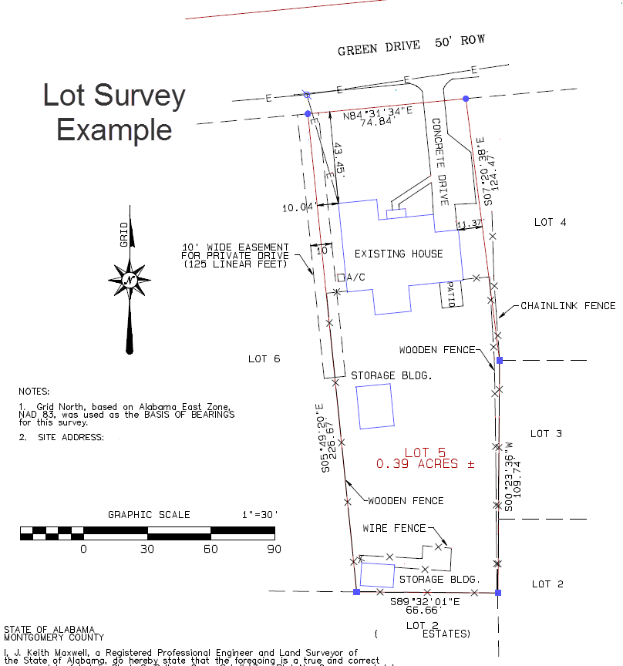
Exclusion:
“Any discrepancy in the quantity of the area, square footage, or acreage of the Land or any improvement to the Land.”
These risks were generally excepted from coverage in Schedule B but are now specifically addressed in this new Exclusion.
Suggestion to commission surveys to purchasers?

Slide 23
Vermont Offices
“I love E-Remit and E-Submit. Has made my process much more efficient!”
-Solo, Lamoille County
“E-Submission and E-Remittance has been very smooth.”
-Solo, Bennington County
“The process was very easy to do once I figured out my password for StavvyPay.”
-Multi-Attorney Office, Addison County

Slide 24
Express your interest and receive an invitation
“You’ve been invited to join StavvyPay”
StavvyPay Portal Setup
Manage your Bank Accounts IOLTA – Add Account/s

Slide 25
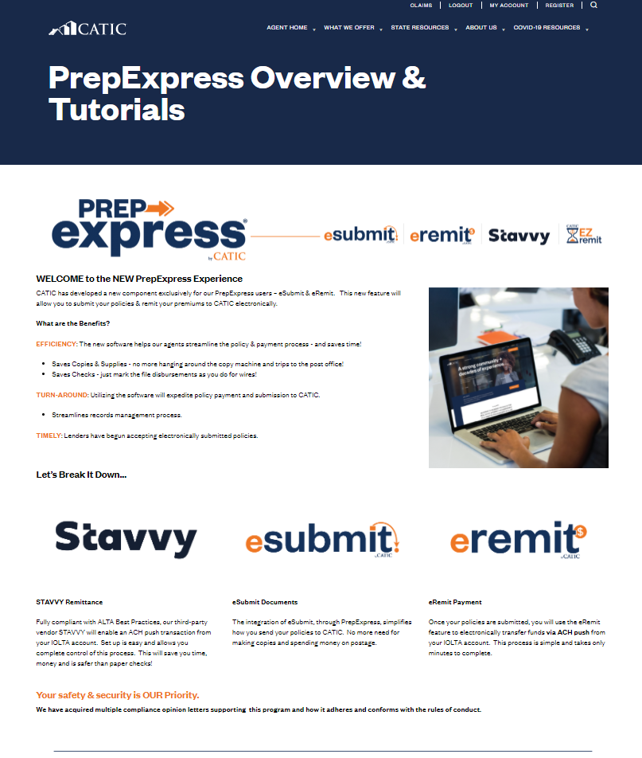

Slide 26
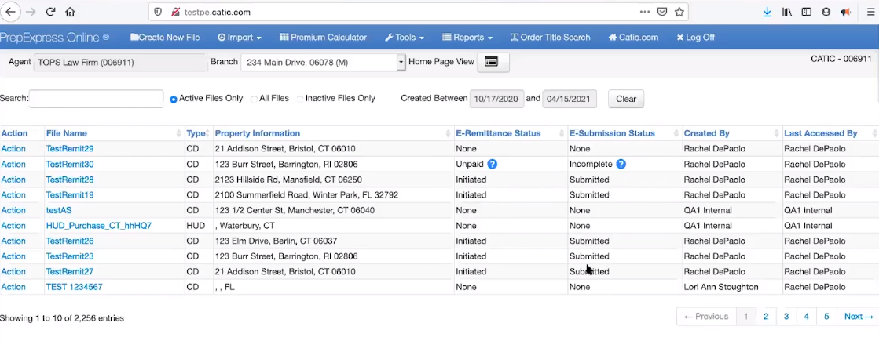
WELCOME to the NEW PrepExpress Experience
CATIC has developed a new component exclusively for our PrepExpress users – eSubmit & eRemit. This new feature will allow you to submit your policies & remit your premiums to CATIC electronically.
New Status Columns
Review CD against E-Submission Page
E-Remit and Done

Slide 27
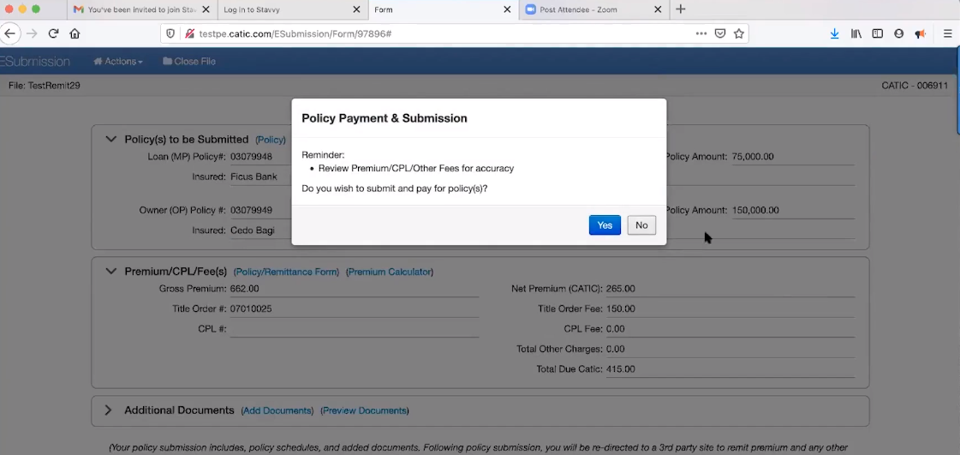
WELCOME to the NEW PrepExpress Experience
CATIC has developed a new component exclusively for our PrepExpress users – eSubmit & eRemit. This new feature will allow you to submit your policies & remit your premiums to CATIC electronically.
Review Policies and Fees
Pay for Policies – Click Yes
E-Remit and Done

Slide 28
E-Remit and E-Submit
Can’t submit incomplete policy
Automatically submits simultaneous policies – OP and MP
Manual overrides available on Transmittal Form
Add Comments feature
Compliance certified
Data protection

Slide 29
Partnership and Integration

Slide 30
The Future of Post-Closing Update Ordering

