Slide 1
WELCOME! We will be with you shortly.

Slide 2
Solar Panels, Mobile Homes and UCCs - Oh my!

Slide 3
2021
Questions during the program?
Use the Q&A at bottom of your screen and type them in. We will answer questions at the end of the program.
CLE Certificate will be posted to the Home Page of our website (News/Announcements)
This video will be archived (with others) on our website.
Next Month’s Program: February 10, 2021
You will receive a Zoom invite
Topic: Common Interest Community Refresher
VATC updates with Andy

Slide 4
Title 9A – Uniform Commercial Code
"Fixture filing" means the filing of a financing statement covering goods that are or are to become fixtures and satisfying section 9-502(a) and (b).
"Fixtures" means goods that have become so related to particular real property that an interest in them arises under real property law.
Filing requirements 9-502: properly name parties; indicate type of collateral; provide sufficient description of real property to which collateral is related; indicate it is to be filed in the land records.

Slide 5
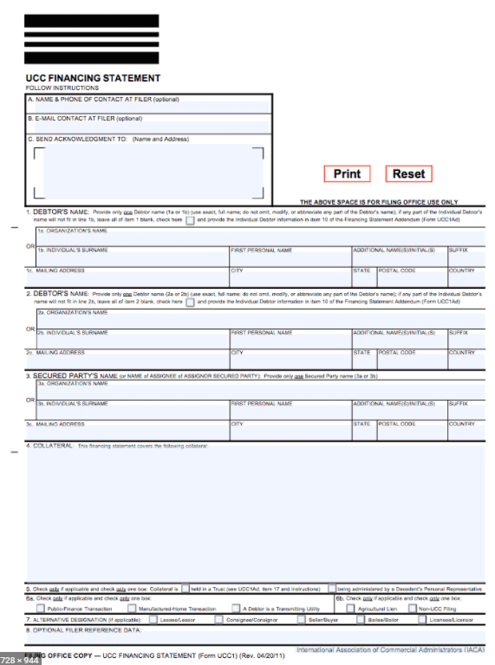
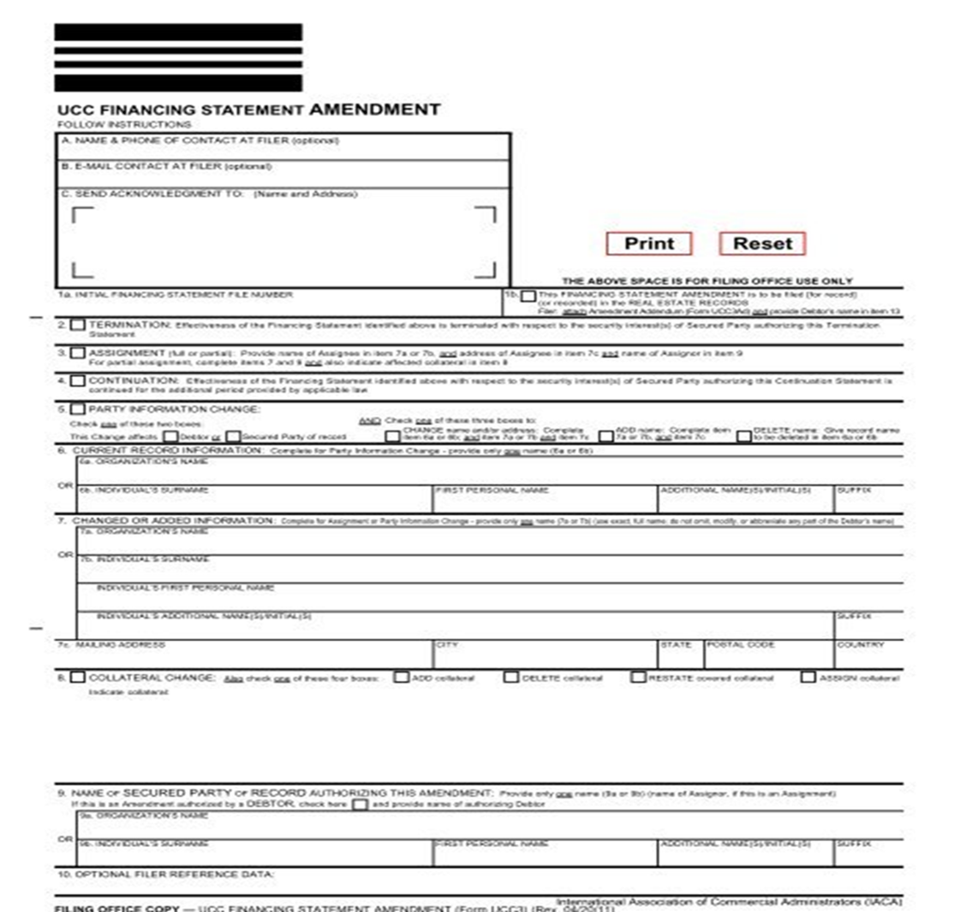

Slide 6
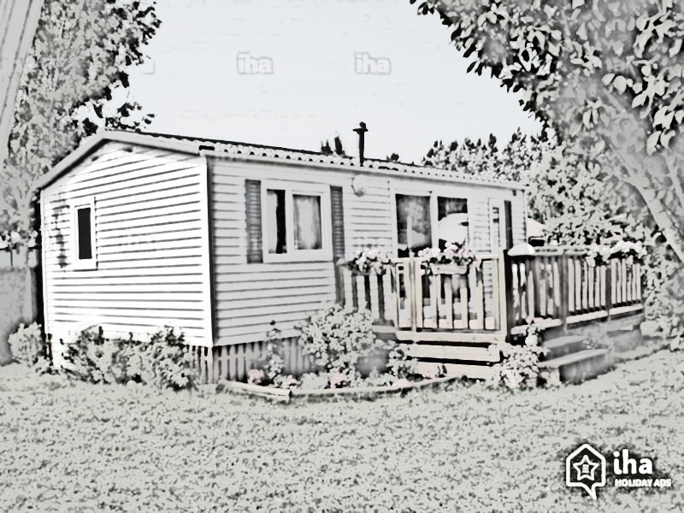
UCCs - Duration and effectiveness
Mobile Home
Solar Panel
9 VSA 9-515(b)
30 years after date of filing
9A VSA 9-515(a)
5 years after date of filing

Slide 7
UCCs – SOLAR PANELS
1
2
3

Slide 8
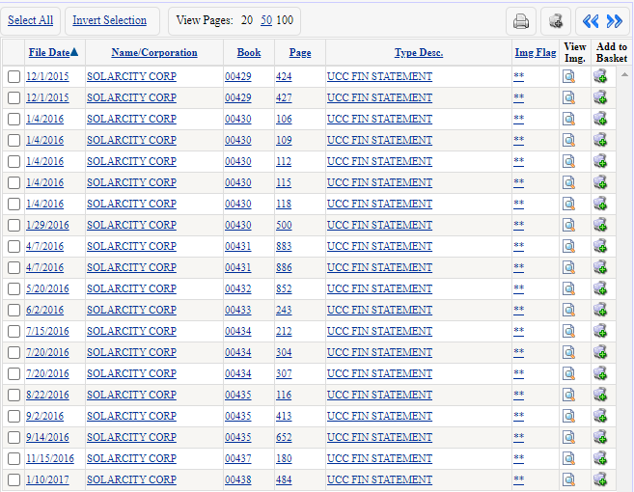
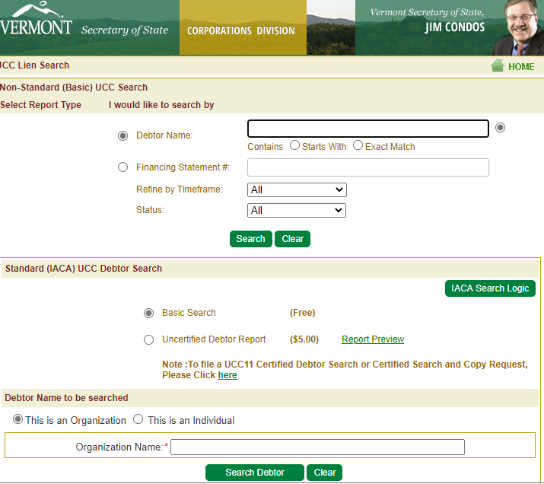
SOLAR PANEL UCCs
https://bizfilings.vermont.gov/Online/UccInquire/
Land Records Search
Notes:
Mention Freddie Mac Bulletin December 2, 2020

Slide 10
MOBILE HOME CONVEYANCE?
MOBILE HOME - FEE
MOBILE HOME - LEASEHOLD

Slide 11
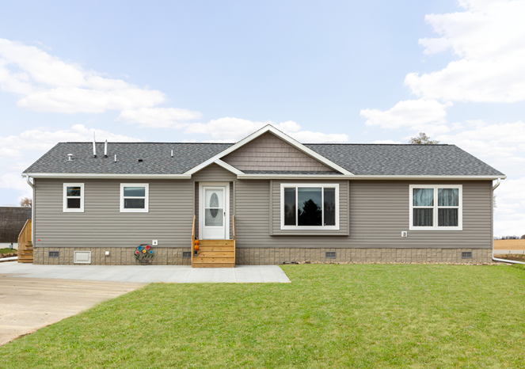
FEE SIMPLE
This Photo by Unknown Author is licensed under CC BY-SA

Slide 12
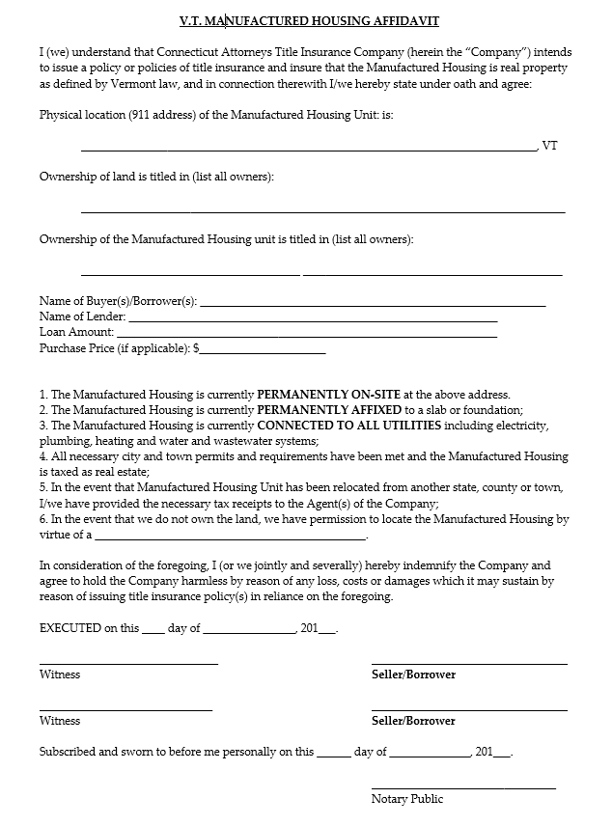
1. The Manufactured Housing is currently PERMANENTLY ON-SITE at the above address.
2. The Manufactured Housing is currently PERMANENTLY AFFIXED to a slab or foundation;
3. The Manufactured Housing is currently CONNECTED TO ALL UTILITIES including electricity, plumbing, heating and water and wastewater systems;
4. All necessary city and town permits and requirements have been met and the Manufactured Housing is taxed as real estate;
5. In the event that Manufactured Housing Unit has been relocated from another state, county or town, I/we have provided the necessary tax receipts to the Agent(s) of the Company;
6. In the event that we do not own the land, we have permission to locate the Manufactured Housing by virtue of a _______________________________________________.
Title Search: Conduct a 40 year title search.
UCC Search: Search the Secretary of State website and the land records for UCC filings. Any UCC’s must be terminated.
Property Description: Make express reference to the mobile home (e.g. the number, make, model, year and/or color), or use a phrase such as “Being all of the land and premises, with improvements thereon …”.
Financing: Manufactured Housing Endorsement required. Manufactured Housing Affidavit need not be recorded. Please retain the signed copy in your file and attach a copy to the final policy remitted to CATIC.
MH Endorsement: Collect the $100 endorsement fee at closing and add the fee to the Title Insurance Invoice and Transmittal Sheet when you remit the policy.
PrepExpress: To add the Endorsement fee, go to Premium Calculator; Charges I; check the box for Vermont Manufactured Housing.

Slide 13
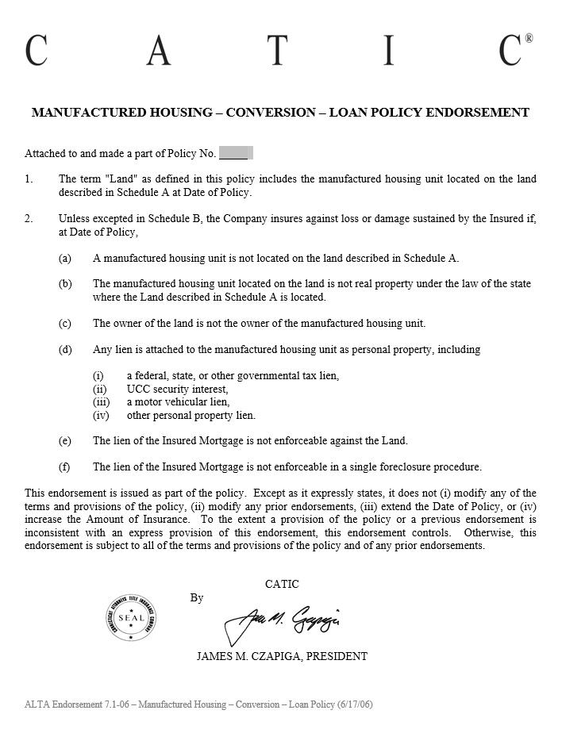
ALTA
7.1

Slide 14
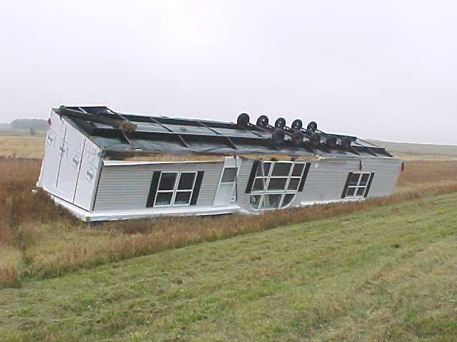
What could go wrong?
Transition from Personal Property to Real Property
MHBOS issues
No mention of mobile home in deed
Original MHBOS absent from Land Records
Separate MHBOS from Deed
Tenancy not included
UCC remains
UCC and Mortgage

Slide 15
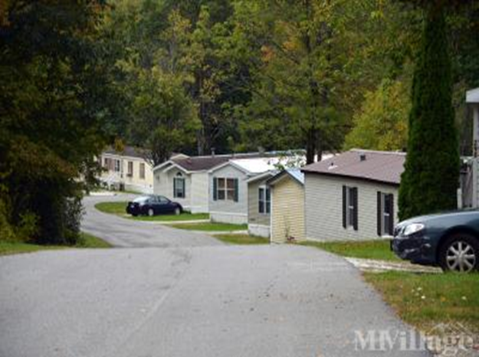
LEASE

Slide 16
Mobile Home Lease (a) Unit is owned by the Borrower, (b) the Unit is affixed to land leased by the Borrower and (c) there is a recorded lease/or memorandum between the Borrower and the fee owner
Title Search
Insurance
What if…
40 year title search on the land (i.e. typically a MH park).
UCC Search: Search SoS’s website and Land Records. Any UCC’s must be terminated.
Property Description: The mortgage description and policy description should provide:
“Being the leasehold interest in property located at [911 address], together with all improvements including a Manufactured Home [if possible, add additional identifiers like the number, make, model, year and/or color of the Unit] as described in a lease dated ______, 20___ a copy or a memorandum of which is recorded in Book ___, Page ___ of the land records.”
Standard Protection Policy.
Commitment: In addition to typical Requirements and typical Exceptions add:
Schedule B, Requirements:
Obtain written confirmation from landlord (fee owner) that the lease is in full force and effect, is not in default and the rent is paid to date.
Execute and record lease or a memorandum thereof in the land records.
Seller or refinance borrower to execute Manufactured Housing Affidavit.
Final Policies will issue with an ALTA Leasehold Endorsement – Series 13
No Lease/Lease not recorded. Where the Unit is owned by Owner/Borrower but there is no lease or, if there is a lease, there is nothing recorded in the land records, do not insure the Unit.
Unit Not Affixed. Where the Unit not affixed to land do not insure the Unit.
Personal Property v. Real Property

